Slide 1
Bidders’ conference
Ohio Works First
Work Activities
Services & Management
Wednesday, June 21, 2017 ~ 2 PM
F C D J F S

Slide 2

Welcome & Introduction of
FCDJFS Team Members

Slide 3
Discussion Topics
Mandatory Letter of Intent
Purpose of the RFP
CCMEP Overview
Ohio Works First Overview
Budget
RFP Proposal Submission
Important Dates
Pre-Bidders’ Conference Q & A

Slide 4
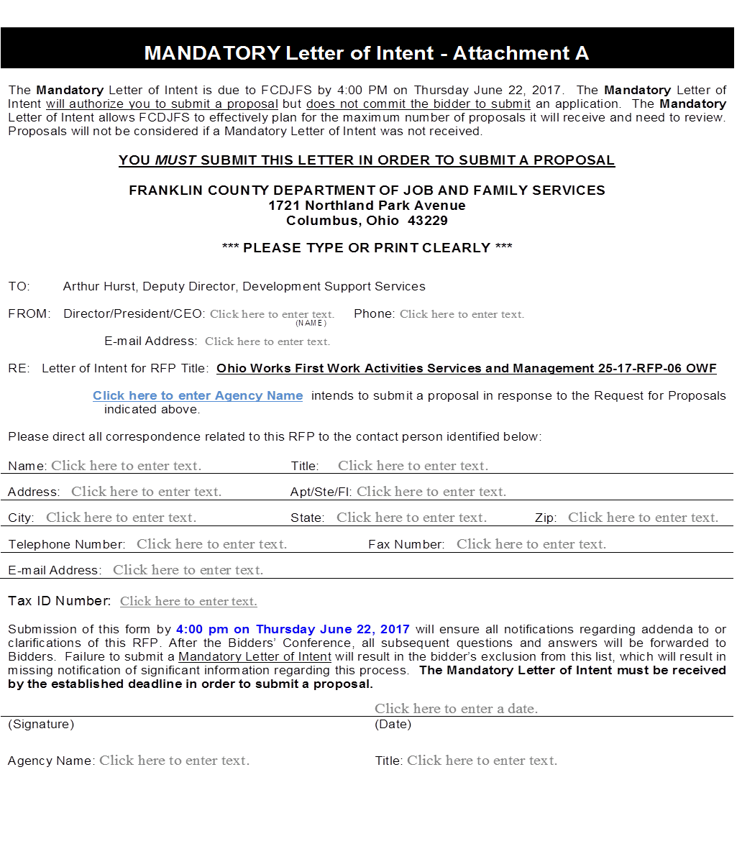
Mandatory Letter Of Intent
Must submit a Mandatory Letter of Intent in order to Submit a Proposal
FCDJFS Form- Attachment A
  Page 25 of the RFP
Must be Signed by the Agency Director/President/CEO
Agency’s Tax Identification Number is required
Approved Submission Formats:
  Email, Hand Delivered or US Mail
Due Thursday, June 22nd by 4 PM

Slide 5
Purpose
The passage of the Deficit Reduction Act of 2005 (DRA), requires Adult TANF Recipients (with a few exceptions) to participate in a work activity in order to receive cash benefits
Work activity will be conducted under the Ohio Works First (OWF) program and the Comprehensive Case Management and Employment (CCMEP) program
FCDJFS is the local governmental entity responsible for the administration of these programs
FCDJFS is seeking proposals from qualified organizations to assist us with the provision of services and management of the major work activity requirements of the Ohio Works First Program

Slide 6

CCMEP Overview
Ohio’s new framework for youth employment services – “New Way to Work”
Eligible Participants:
  Youth ages 16-24
  In School and Out of School
  WIOA Eligible
  TANF Eligible
Mandatory Participants: Individuals who participate in the OWF Program or who are enrolled in a WIOA Youth Program
Voluntary Participants: Other TANF Eligible youth in the age category of 16-24

Slide 7
CCMEP Overview
Possible expansion to 14-15 year olds, pending new legislation for the new biennium
Program Services:
  Case Management Services
  Assessment and Individual Opportunity Plan (IOP)
  14 Core Elements
  CCMEP Activities
  Supportive Services

Slide 8
CCMEP Overview
Additional Program Requirements:
  Must use the Ohio Workforce Case Management System (OWCMS)
  Each participant must register in Ohio Means Jobs (OMJ)
Funding:
  WIOA Funds managed by the Workforce Development Board of Central Ohio
  TANF Funds managed by Franklin County Department of Job and Family Services

Slide 9
Ohio works first program overview
O
W
F

Slide 10
Ohio Works First Program Overview
Once an OWF customer is determined “Work Required” and completes the Applicant Job Search they must participate for a prescribed number of hours in a federally established appropriate work activity/activities according to the composition of their household
All work eligible individuals shall be assigned to one (1) or more work activities or alternate activities
  FCDJFS may exempt certain individuals or assign them to alternate work activities

Slide 11
Ohio Works First Program Overview
FCDJFS is responsible for:
  Determining the work activity and the required number of hours for each customer
  Tracking and reporting the participation hours completed to ODJFS (Ohio Department of Job and Family Services)
  Imposing penalties or sanctions on customers who fail to complete their assigned work activity
  Conducting State Hearings when necessary

Slide 12
Ohio Works First SCOPE of Work
Five (5) Key Components:
  The service delivery of the required work activities of referred customers and when necessary the recommendation of sanctions
  The coordination and service delivery of case management and supportive services for referred customers (CCMEP customers will be Case managed by FCDJFS; Non-CCMEP customers should receive case management service from the provider)
  The management, tracking, analysis and reporting of the referred customers’ demographics, service needs, work participation and performance
  The development and management of employer engagement services for WEP, OJT and subsidized/ unsubsidized employment
  The provision of employment placement and retention services for referred customers.

Slide 13
Ohio Works First Program Overview
Allowable Work Activities:
  Unsubsidized employment
  Subsidized public or private employment
  Work experience program
  On-the-job training
  Job search and job readiness assistance
  Community service
  Vocational educational training
  Providing child care services to an individual who is participating in a community service program (this must be approved by FCDJFS prior to utilization)

Slide 14
Ohio Works First Program Overview
Allowable Work Activities (continued):
  Job skills training directly related to employment (Must include services such as ESOL (English for speakers of other languages for the limited English Proficiency and Refugee communities)
  Education directly related to employment in the case of a recipient who has not received a high school diploma or a certificate of high school equivalency
  Satisfactory attendance at secondary school or in a course of study leading to a certificate of general equivalence, in the case of a recipient who has not completed secondary school or received such a certificate
  Alternate Work Activities

Slide 15
OWF- Data Collection, Tracking, Analysis & Reporting
Customer Identification and Contact Information
Customer Demographics
Case name
Case number
SSN
Address
Email
Phone numbers (home/cell)
Emergency Contact
Ethnicity, Race, Gender
Primary language
Citizenship
Marital status
Disability
Education level
Employment history
Legal/Criminal history

Slide 16
OWF- Data Collection, Tracking, Analysis & Reporting
Case Management Services
Referral Information
Identified needs and/or barriers
Action steps to address barriers
Referrals and linkages to services
Community services utilized
Supportive Service Provided (CCMEP & Non-CCMEP)
FCDJFS support services utilized
Date referred
Date scheduled for Applicant Job Search (if applicable)
Show Date/No Show Date
Hours Completed

Slide 17
OWF- Data Collection, Tracking, Analysis & Reporting
Assignment Information
Assignment Details
Site Information
Site Name
Site Address
Site Contact Person
Site Contact Information
PSC code, provided by FCDJFS
Start date of assignment
End date of assignment
Duration of assignment
Number of hours assigned
Proposed Assignment Changes

Slide 18
OWF- Data Collection, Tracking, Analysis & Reporting
Participation Tracking
(Day/Week/calendar month):
Sanctions:
Hours required (including those deemed)
Hours completed
Hours missed
Hours with good cause (must be supported by documentation)
Participation Met/Failed
Date of sanction recommendation
Reason for sanction recommendation
Decision by FCDJFS (approved for sanction action or remain in assignment with Selected Provider)

Slide 19
OWF- Data Collection, Tracking, Analysis & Reporting
If Sanction Recommendation
is Approved:
Applicant Job Search/Compliance Job Search
Status of sanction (pending, fair hearing, applied)
Date sanction applied
Date sanction is to be lifted
Sanction Tier (I,II, or III)
Date referred
Date scheduled for Applicant/Compliance Job Search (if applicable)
Show Date/No Show Date
Hours Completed

Slide 20

FCDJFS OWF Customer Data
Of the FCDJFS OWF Work Required Population:
  The average age is 34
  Customers received cash assistance for an average of 14 months
  26% of customers spoke a primary language other than English
  76% are male and 24 % are female
  72% of households are single-parent and 28% are two-parent

Slide 21
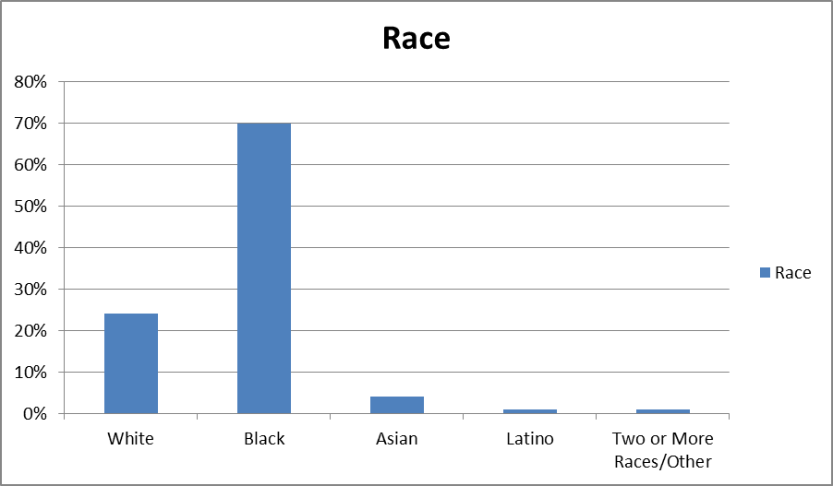
FCDJFS OWF Customer Data
Of the FCDJFS OWF Work Required Population:

Slide 22
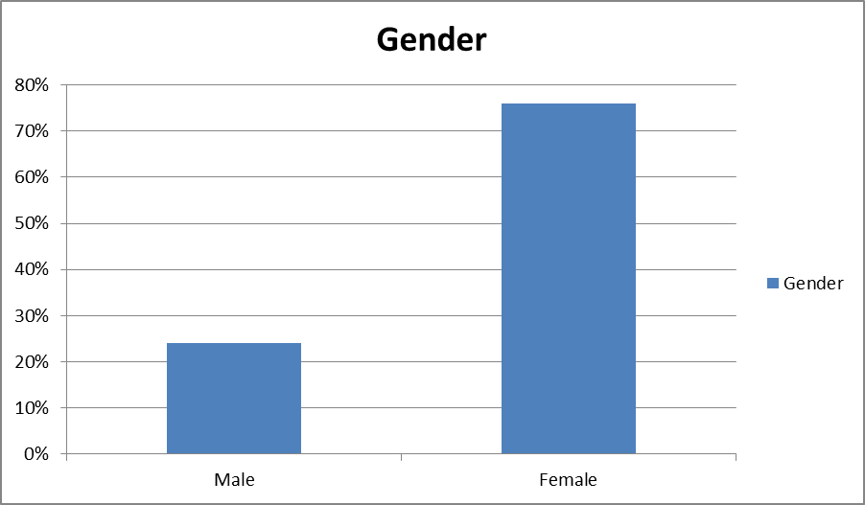
FCDJFS OWF Customer Data
Of the FCDJFS OWF Work Required Population:

Slide 23
FCDJFS OWF Customer Data
Of the FCDJFS OWF Work Required Population:

Slide 24
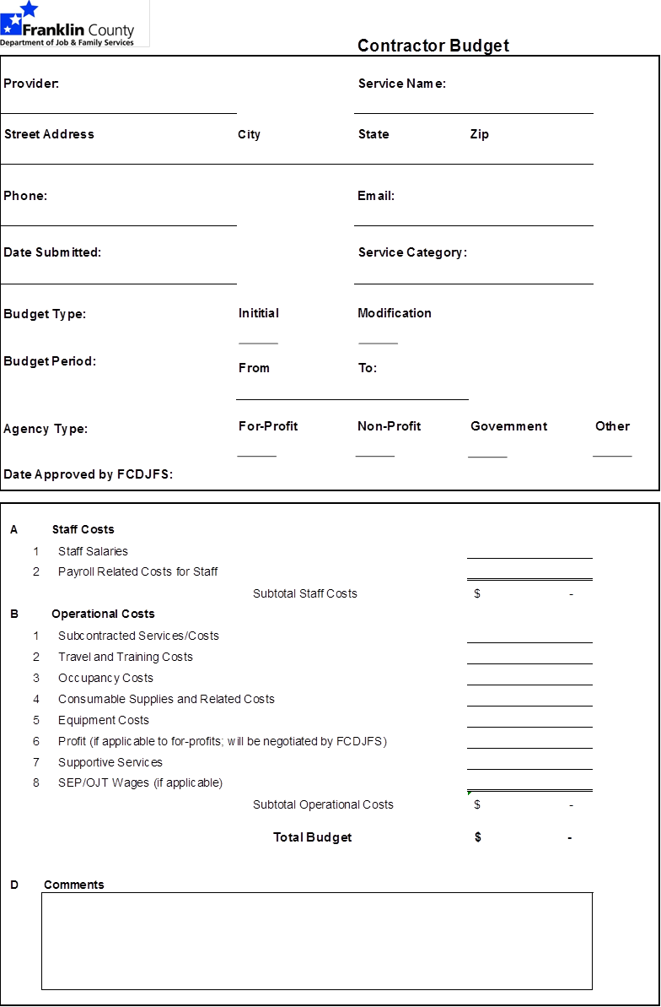
B
U
D
G
E
T
Bidders’ must
use the Budget
Document
provided
by FCDJFS
A Fully Completed
Budget Must be
Submitted

Slide 25

Minimum Requirements
Formatting
Important Dates
Proposal
Submission

Slide 26
Minimum Requirements
Have a minimum of three (3) years of experience managing work activity and workforce services and programming for OWF customers;
Have a minimum of three (3) years of experience of successfully managing similar size and scope projects;
Demonstrate the organizational capacity to manage the size and scope of the services identified in the RFP as demonstrated by a thorough staffing plan, management structure and project timeline
  Staffing plan must include education, career history, workforce development competencies and experience, staff position descriptions, resumes,
  Management Plan must demonstrate the overall structure of the proposed service delivery model and how that structure will be sufficiently managed. This should be inclusive of all established and proposed subcontracted relationships.
  Project timeline should include but not be limited to hiring and training, services schedules, reporting timelines and other major activities related to the operation of these services

Slide 27
Minimum Requirements
Demonstrate the ability to manage work activities and provide services (i.e. WEP, Community Service, Job Placement) to the projected number of customers as evidenced by existing partnerships and relationships with local service providers, public and private business sectors and other relevant local entities and community organizations
Case Managers must have at least three (3) year of experience providing community based case management with similar populations. Degreed or credentialed staff is preferred but not mandated.

Slide 28
Minimum Requirements
Demonstrate the technology infrastructure and capacity to manage the project and all requisite data as evidenced by electronic case management, timekeeping and reporting systems. The organization must have data back-up processes and disaster recovery plan.
Demonstrate sound fiscal and administrative management inclusive of an accounting system with adequate financial controls; adequacy of approved cost allocation plan; audits and fiscal monitoring reports free of unresolved findings; historically accurate and timely financial and programmatic information; and

Slide 29
Minimum Requirements
Demonstrate how the Selected Provider will provide services that are culturally and linguistically appropriate. Bidders must provide meaningful access to services to all eligible customers. The ODJFS Office on Civil Rights defines meaningful access as: the ability to use services and benefits comparable to those enjoyed by members of the mainstream cultures. It is achieved by eliminating communication barriers and ensuring that the client or potential client can communicate effectively. An organization must ensure that the LEP (limited English Proficient) person:
  Is given adequate information
  Is able to understand the services and benefits available
  Is able to receive services for which he or she is eligible
  Can effectively communicate the relevant circumstances of his or her
  situation to the service Selected Provider; and
  Receives language assistance at no cost.

Slide 30
Minimum Requirements
Bidders who do not meet all the referenced qualifications will be disqualified
from further consideration!

Slide 31
Proposal format Overview
Proposal Packet:
  Proposal Packet Cover Sheet
  Proposal Packet Table of Contents Form
  Proposed Services Narrative Template
  Proposal Attachments (Required)
  Proposal Attachments (Optional)
  Proposal Budget
Required Documents Packet:
  Required Documents Packet Cover Sheet
  Required Documents Packet Table of Contents Forms
  All Required Documents and Forms listed on the Table of Contents must be attached

Slide 32
Proposal format Instructions
Binder Clips- All components of the Proposal and Required Documentation packets must be held together by binder clips at the upper left corner
Page Numbers- Page numbers must be included on every page of the proposal submission and all required documents
Paper Size- All pages must be on standard 8½” x 11” letter size paper
Font Size – Must be a minimum of 11 point font
One Sided Copies- Proposals and Required Documents must be submitted as one sided copies
Blue Ink- All documents requiring signature must be signed in BLUE ink
Originals- the 1 Proposal Packet and the 1 Required Document Packet must be marked “ORIGINAL”

Slide 33
Important dates
Please adhere to the following DEADLINES:
Event | Date | Time | General Information
Mandatory Letter of Intent Deadline | Thursday June 22nd | 4 PM | Submit in Person at the Bidders’ Conference or Email Letter of Intent to dssrfp@fcdjfs.franklincountyohio.gov
Post Bidders’ Conference Q & A Questions Submission Deadline | Wednesday July 5th | 4 PM | Email Questions to dssrfp@fcdjfs.franklincountyohio.gov
Post Bidders’ Conference Q & A Responses Emailed by | Friday July 7th | 4 PM | Responses Emailed to Bidders Approved to Submit a Proposal & will be Posted on FCDJFS Website
Proposal Submission Deadline | Friday July 14th | Noon | Proposals Must be in Our Office by Noon Proposals will Accepted at the West (Employee) Entrance Only

Slide 34
Pre-Bidders’ conference
Questions & Answers
Q & A

Slide 35
Q & A
Will Reference: “Maintenance of documentation of the delivery of services, inclusive of, but not limited to data elements listed in sections 3.2 Case Management Services and 3.3 Data Collection, Tracking, Analysis and Reporting”. The referenced paragraph numbers do not appear in the RFP. Please confirm these should refer to paragraphs 4.2 and 4.3.
ANSWER: Yes. The documentation of services should refer to section 4.2 and 4.3.

Slide 36
Q & A
Does a “Table of Organization for the Agency” mean a corporate organization chart?
ANSWER: Yes. The RFP requires a Table of Organization for the bidding entity regardless of the structure of the entity. It also requires a Table of Organization for the Project.

Slide 37
Q & A
This section states, ”If supportive services are determined to be in need the selected provider will pay for the service and be reimbursed by FCDJFS upon invoicing for the service.” Historically, what have been the monthly costs incurred by the current contractor for supportive services? Please provide data for the past year.
ANSWER: Year to Date for FFY17 FCDJFS has paid out approximately $68,400.00 in supportive services under the current contract. A monthly average is not provided due to the implementation of CCMEP and a subsidized employment program mid-way through the contract which skews the monthly average. After implementation of both of these new services monthly average costs are approximately $19,000. However, this amount should not be the only factor in deciding how much to allocate towards supportive services. FFY17 was the first year of CCMEP which has a more broad and flexible definition of supportive services. Future spending of supportive services may look very different than past years. Additionally, for customers age 25 and older, CCMEP supportive services will not be available. The Bidder can include similar supportive services for education and employment for Non-CCMEP customers but other supportive services, such as housing, will have to be accessed through the PRC Emergency Assistance Program. FCDJFS, due to prohibitive tracking requirements, does not allow for the purchase of gift cards (for gas or any other supportive service).

Slide 38
Q & A
Please define the “data elements that will be frequently transmitted between FCDJFS and the Selected Provider.”
ANSWER: The data elements that will be frequently transmitted are all those elements and reports listed on pages 11-13 of the RFP plus any additional requirements as determined by program needs. The bidder should expect to have regular, on-going communication with FCDJFS regarding customers being served regarding matters such as, but not limited to, case information (updates, changes), assignments, participation, sanctions, case management and supportive services. The bidder must have a system to document, track and report data requests to FCDJFS.

Slide 39
Q & A
Who is the current provider or providers for this service?
ANSWER: Arbor E&T dba ResCare Workforce Services.
Will provider staff have access to CRIS-E?
ANSWER: No.
Will the provider use OWCMS for CCMEP individuals and non-CCMEP individuals?
ANSWER: At this time it is not anticipated that the selected provider will use OWCMS as FCDJFS has a team of CCMEP Case Managers who are responsible for the data entry into OWCMS. FCDJFS reserves the right to modify this practice if needed to accommodate program needs.

Slide 40
Q & A
Can you clarify “Work Allowance Distribution” (top of page 11). Is the provider responsible for budgeting for transportation assistance, or simply distributing?
ANSWER: Once OWF eligibility has been established, FCDJFS will supply monthly bus passes for customers who are actively participating in their assigned work activity. The selected provider will be responsible for distribution of the monthly pass. It is expected that the selected provider budget for and provide transportation assistance during applicant job search assistance (AJS). FCDJFS, due to prohibitive tracking requirements, does not support the purchase of gift cards (for gas or any other service)

Slide 41
Q & A
Is this cost reimbursement and is there a cap on administration?
ANSWER: Yes, this contract is cost reimbursement. Yes, there is a cap on administration fees not to exceed 10%. FCDJFS reserves the right to negotiate profit rates for For-profit entities.

Slide 42
Q & A
Can you describe the current Ohio Work Incentive Program (OWIP) structure?
ANSWER: The current service provider and their subcontractors provide the services inclusive of employment placement and retention. FCDJFS is responsible for documenting, reporting and providing case information to both the service provider and the Workforce Development Board of Central Ohio (WDBCO). The WDBCO is responsible for submitting invoicing to ODJFS for the payment of OWIP services as well as paying the incentive payments to FCDJFS and the customers. FCDJFS reimburses the service providers their share of the incentive payments. The payment rates can be modified by mutual consent of FCDJFS and the WDBCO.
→

Slide 43
Q & A
Can you describe the current Ohio Work Incentive Program (OWIP) structure?
ANSWER (continued):

Slide 44
Q & A
Please verify that the selected provider will need to accommodate 700-800 OWF customers per month.
ANSWER: The total OWF work required population is estimated to be 700-800 per month. The selected provider will be responsible the portion of the total population referred to them. Based on current service levels the estimated number of customers served by the current provider on a monthly basis is approximately 450. This number includes customers for whom the provider is managing their work activity as well as those that that they only serve in applicant job search (AJS). FCDJFS generally maintains management of customers who are meeting participation through employment and those participating in vocation education. However, the selected bidder may need to serve these customers as well if/when they need additional work participation hours to meet requirements such as when vocation education customers are on break from school or when work hours do not meet participation requirements.

Slide 45
Q & A
What is the amount of funding available for this project?
ANSWER: There is not a pre-determined amount of funding set for this project. We expect bidders to submit proposals based on the requirements and minimum qualifications established in the RFP and to provide a reasonable budget to support the proposed services.
Please verify that the only thing required for the budget is the one page document titled “Contractor Budget”?
ANSWER: Yes, the one page budget posted on the website is the required budget for this RFP. FCDJFS does reserve the right to request additional details of costs provided in the budget.

Slide 46
For Questions & Technical Assistance Please Contact Us at dssrfp@fcdjfs.franklincountyohio.gov
C
O
N
T
A
C
T

